Slide 1
Photo-Realistic Single Image Super-Resolution Using a Generative Adversarial Network
Ruchit Vithani (201701070)
Purvil Mehta (201701073)
Bhargey Mehta (201701074)
Kushal Shah (201701111)
Ref: Photo-Realistic Single Image Super-Resolution Using a Generative Adversarial Network
Code : Code Link

Slide 2
Motivation and Context
Image Super Resolution is a widespread problem and have several model with great accuracy and speed up including deep convolutional network.
But the central problem of these models of lacking high frequency component or features remains the same.
The image with the less MSE and high PSNR need not to be necessarily perceptually look good. This motivates to propose perceptual loss in addition to MSE loss to get the better features compared to previously generated fake HR images.

Slide 3
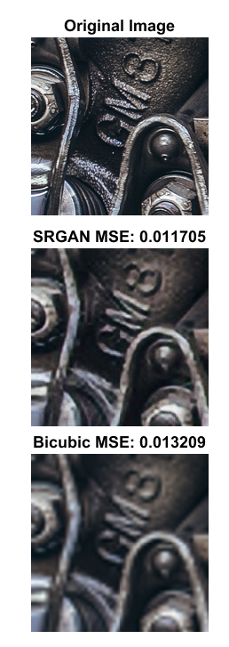
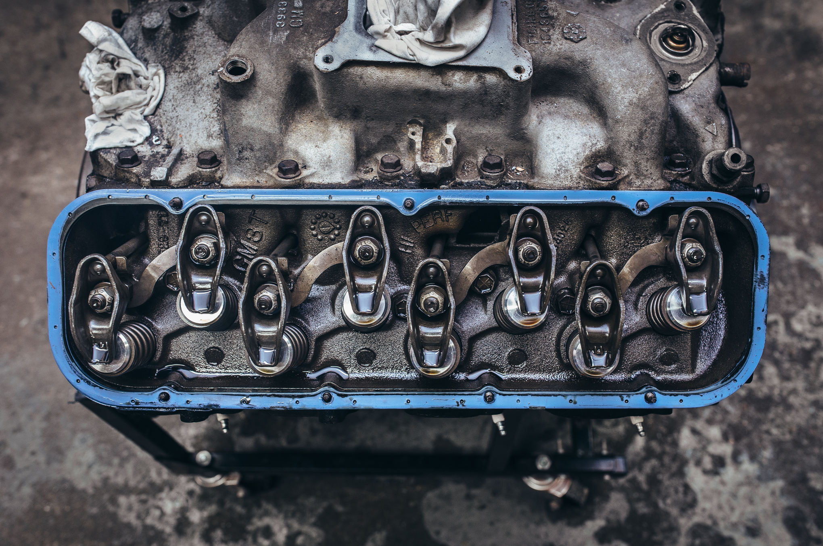
Example
Image Source: DIV2K Dataset

Slide 4
Related Work
31st July, 2015
15th October, 2015
1st August, 2016
11th November, 2016
Image Super-Resolution Using Deep
Convolutional Networks
Chao Dong, Chen Change Loy, Member, IEEE, Kaiming He, Member, IEEE,
and Xiaoou Tang, Fellow, IEEE
Deep Networks for Image Super-Resolution with Sparse Prior
Zhaowen Wangyz Ding Liuy Jianchao Yangx Wei Hany Thomas Huangy
Accelerating the Super-Resolution
Convolutional Neural Network
Chao Dong, Chen Change Loy, and Xiaoou Tang
Deeply-Recursive Convolutional Network for Image Super-Resolution
Jiwon Kim, Jung Kwon Lee and Kyoung Mu Lee
Department of ECE, ASRI, Seoul National University, Korea

Slide 5
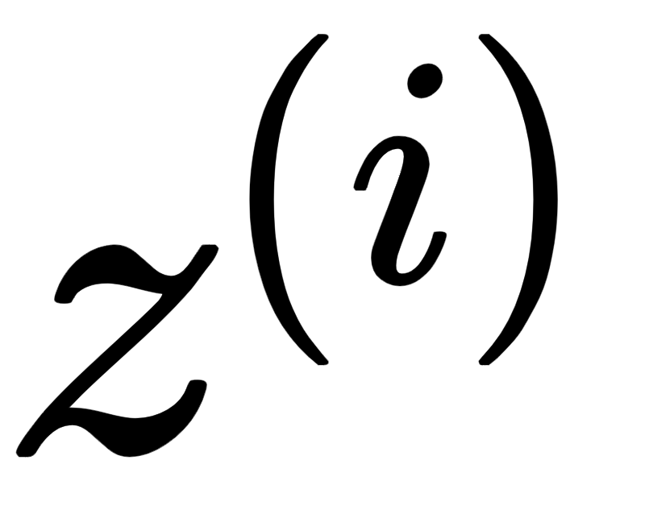
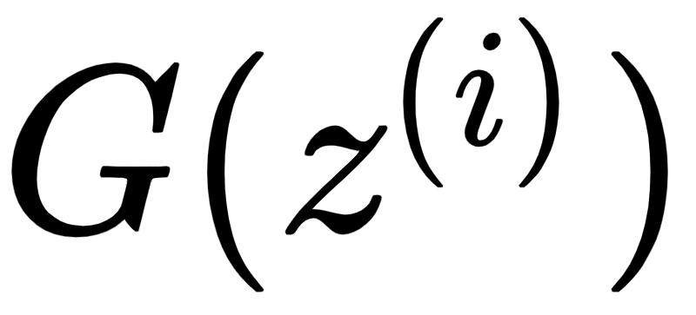
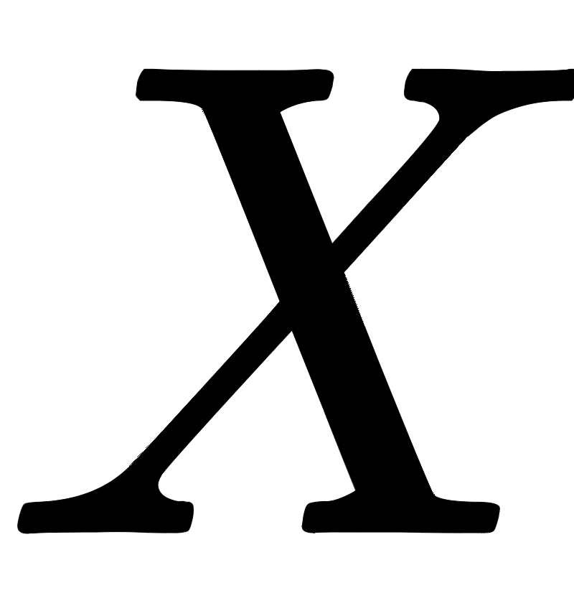
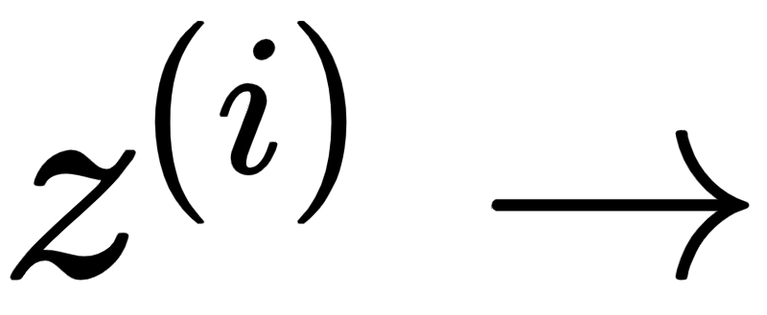
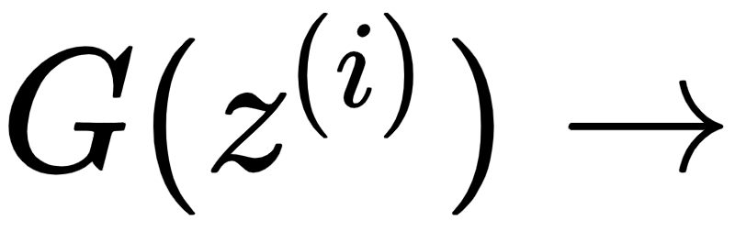
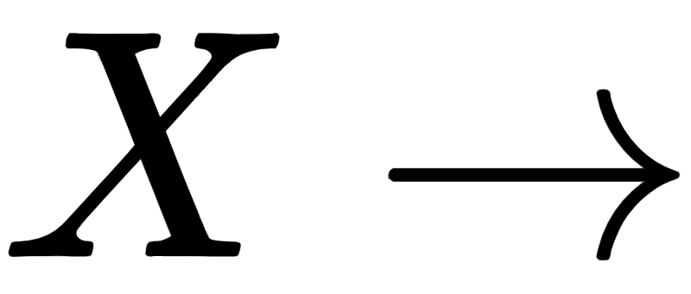
Enter: GAN (Generative Adversarial Network)
GAN- imagine a forger and an authenticator teaching each other to be better
Generative Network - take a seed and produce as close as possible to the original data distribution
Discriminative Network - identify that does NOT belong to the original data distribution
In SISR context:
Low Resolution Input Image
Super Resolution Generated Image
High Resolution Original Image
Aim: Generate super resolution images from input images which are as close as possible to the original high resolution images.

Slide 6
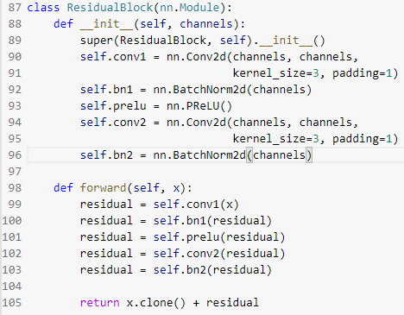
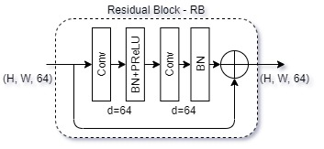
Architecture (Generator)

Slide 7
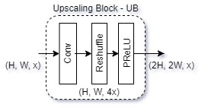
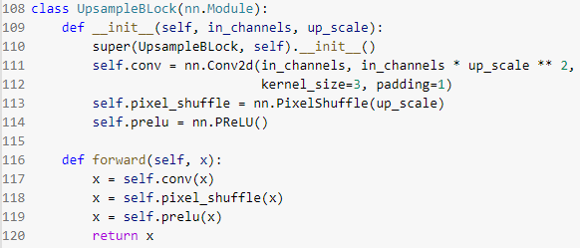
Architecture (Generator)

Slide 8
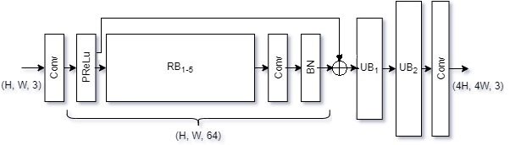
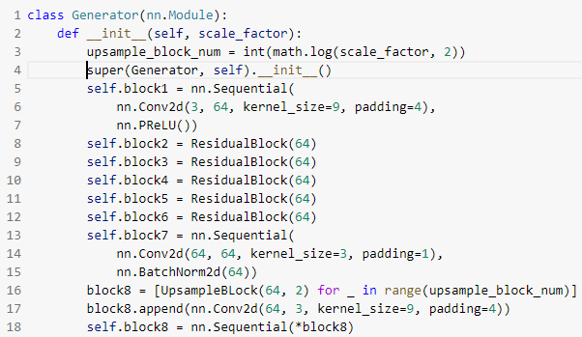
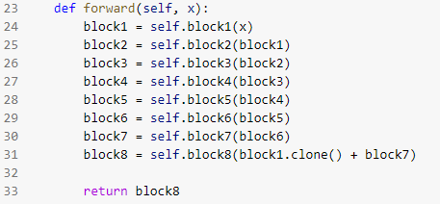

Slide 9
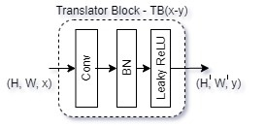
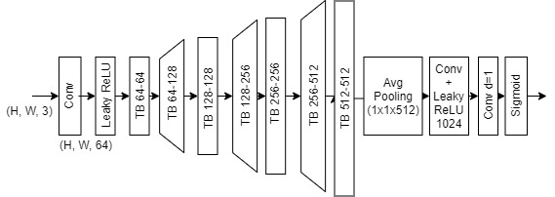
Architecture (Discriminator)

Slide 10
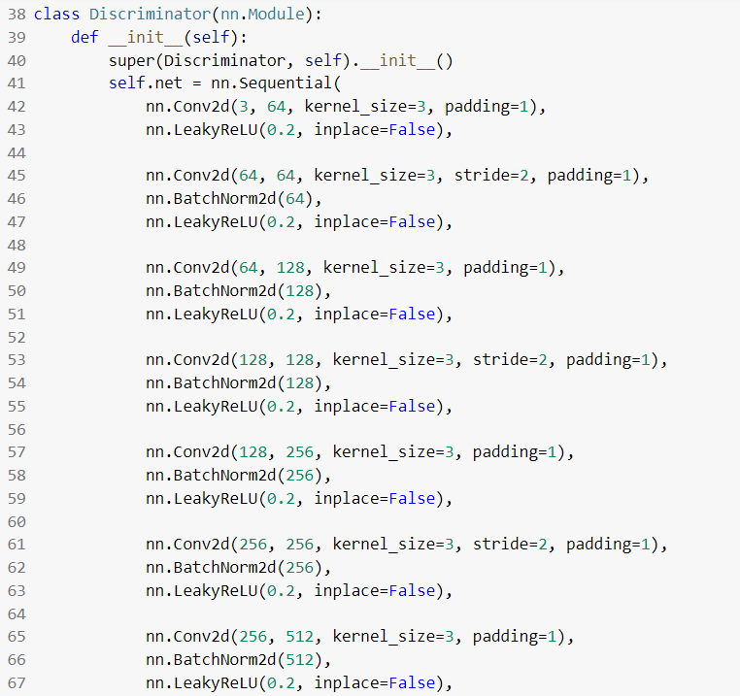
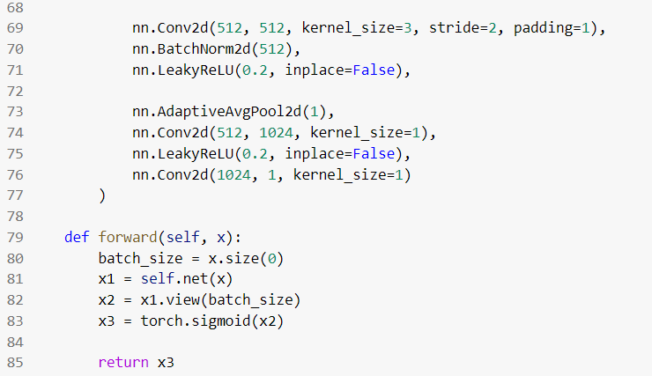
Architecture (Discriminator)

Slide 11
Advocate 1
A noteworthy feature of this architecture is that it utilises a learned upscaling layer instead of first using some interpolation for upscaling like in previous works.
This reduces the computational cost since now the kernels operate on a smaller image instead of the image of final size.

Slide 12
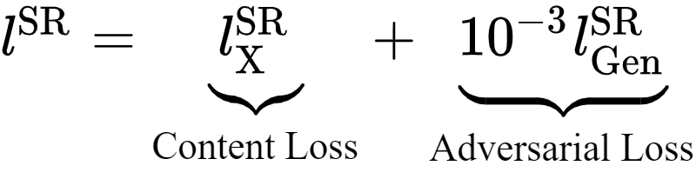
Loss Functions - Purvil Mehta (201701073)
As discussed previously, MSE is the pixel wise average of the square of difference between two images which generates the overly smooth images and has very less perceptual quality. Thus we proposed new loss function to overcome this fact.
Perceptual loss: is defined as a weighted sum of Content loss and Adversarial loss.

Slide 13
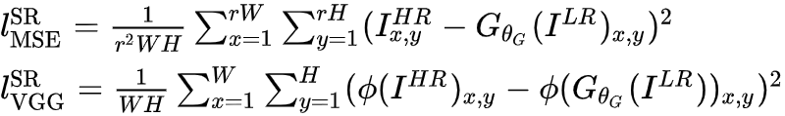
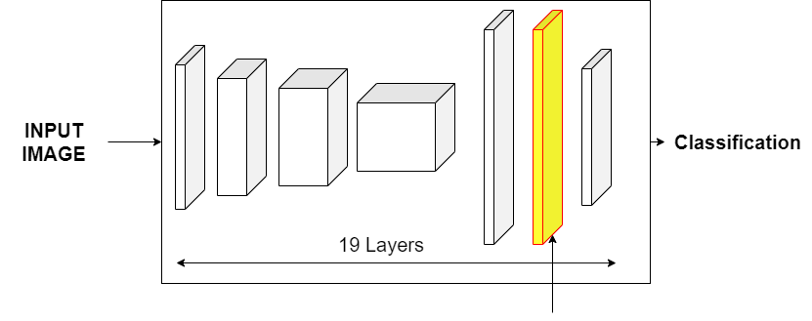

Loss Functions
Content loss : Is generally MSE between two images. Here we considered also MSE between feature maps of VGG19 network at final layer.

Slide 14
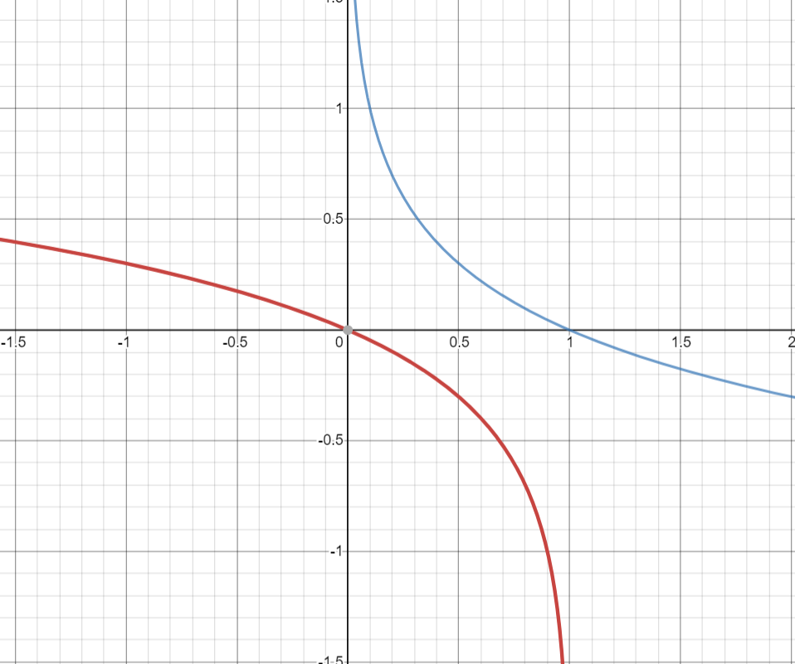
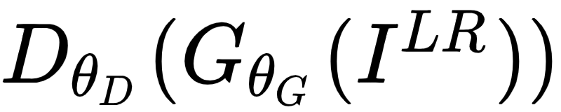
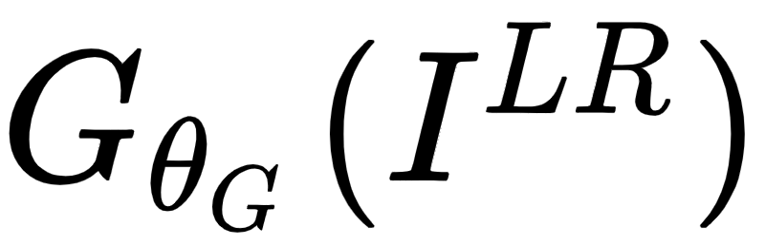
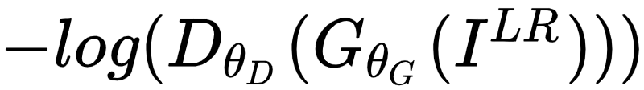
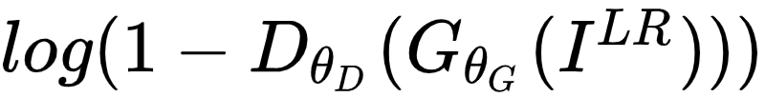
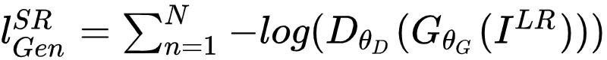
Loss Functions
Adversarial loss : Encourages G network to generate solutions that fool D network. This increases naturally appealing results.
is a probability that the generated image is a natural HR image.
For better gradient behaviour, we minimize instead of minimize
How to code this?
-log(x)
log(1 - x)

Slide 15
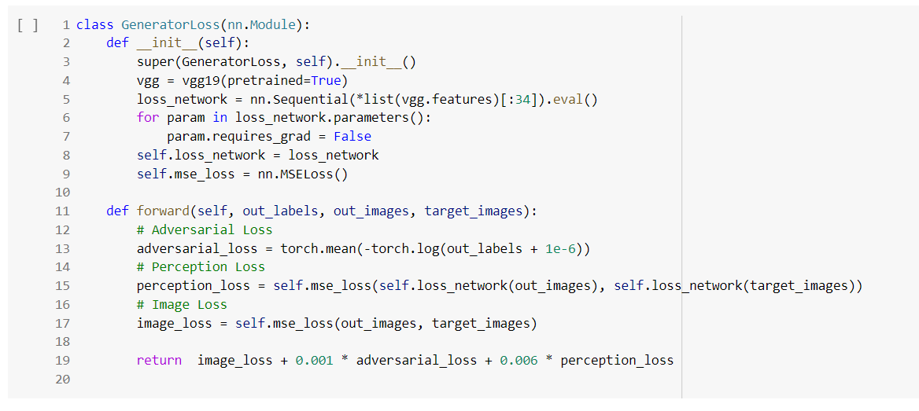
Losses - Code
Fake HR (G(z))
Original HR (z)
D(G(z))

Slide 16
Training - Parameters - Ruchit Vithani (201701070)
Dataset used : DIV2K dataset which contains 800 high definition training images and 100 high definition validation images.
During training, we extract a random crop of size 96x96 from each image for training.
Other hyperparameters :
Leaky Relu (𝛂 = 0.2)
Adam optimizer (𝛃 = 0.9, 0.99)
All our images have been scaled in the range of [0, 1]
Pretrained VGG19 model as feature extractor and for calculation of perceptual loss. We use features from final layer of VGG19
Epochs : 150
We understood the pytorch implementation of the code and trained the G and D model to get the Super resolution images on the said dataset. We used pre trained VGG 19 model (last layer features) to train GAN model in google colab.

Slide 17
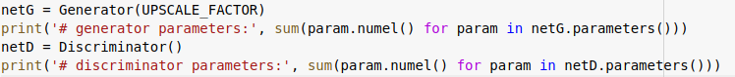
Training process
Model initialisation
Initialise Generator network G
Initialise Discriminator network D

Slide 18
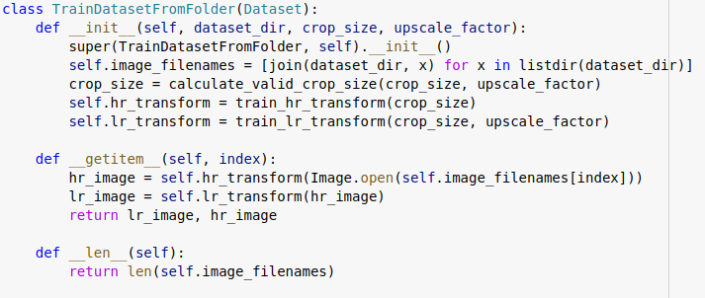
Training process
Dataloader loads mini batches of images from local directory.
From original HR image, returns a random square crop of size crop_size
Downsamples the HR patch, to obtain its corresponding LR patch

Slide 19
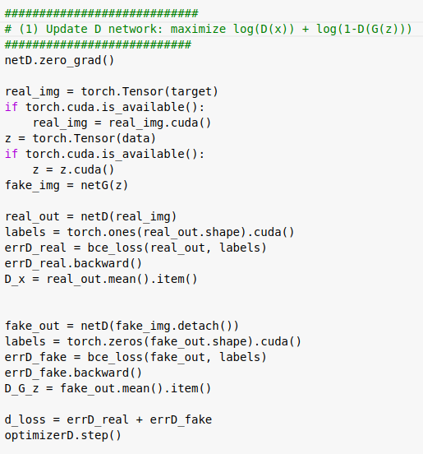
Training process
Update D :
Update Discriminator network.
Compute D(x) (real p). (label = 1)
Compute D(G(z)) (fake p). (label = 0)
Maximize following function.
d_loss = log(D(x)) + log(1-D(G(z)))
Update the parameters of D, keeping G same.

Slide 20
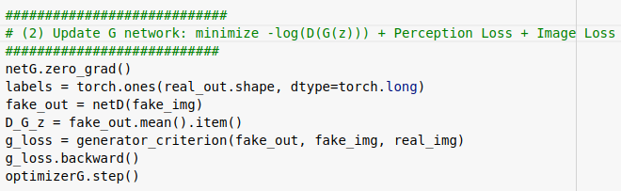
Training process
Update Generator network.
Minimize perceptual loss
We repeat this training process for all mini-batches we obtain from dataloader, and for each epoch.

Slide 21
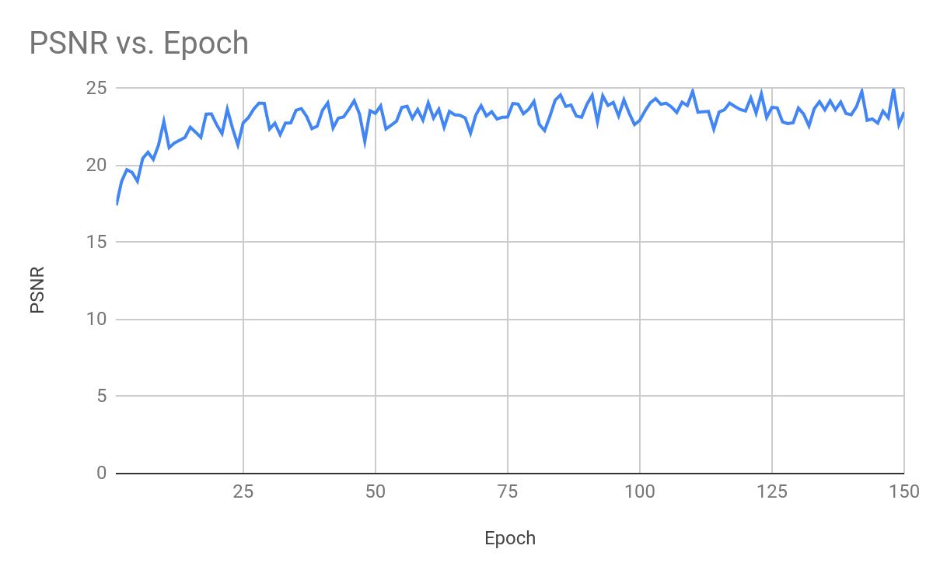
PSNR vs. Epochs on validation set

Slide 22
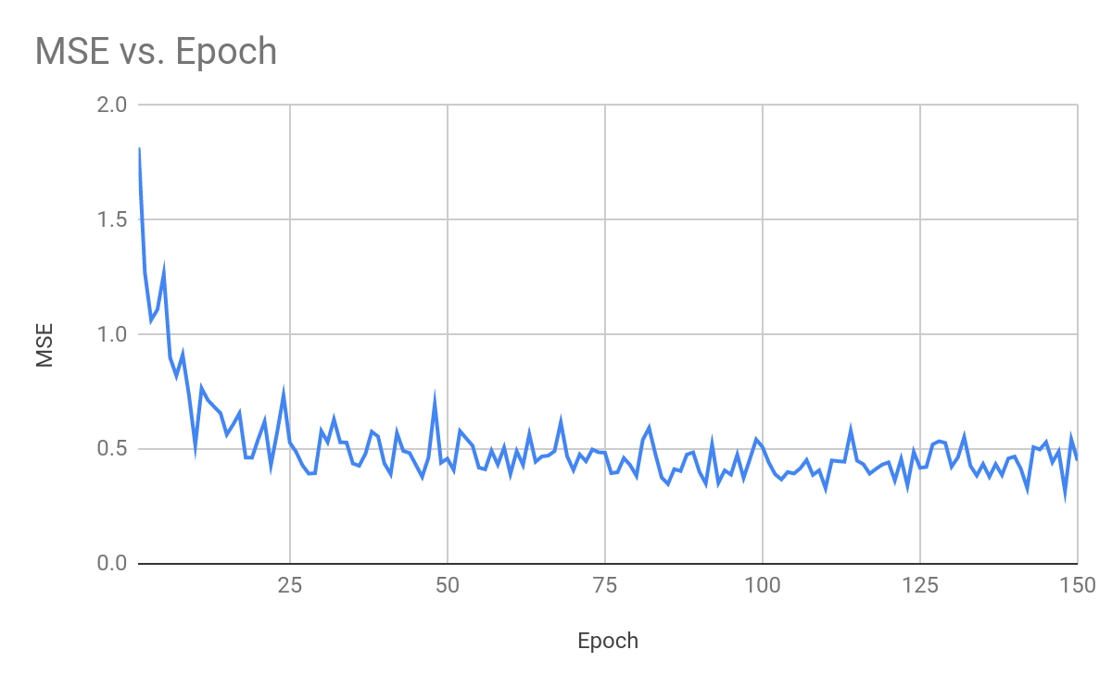
MSE of validation set images

Slide 23
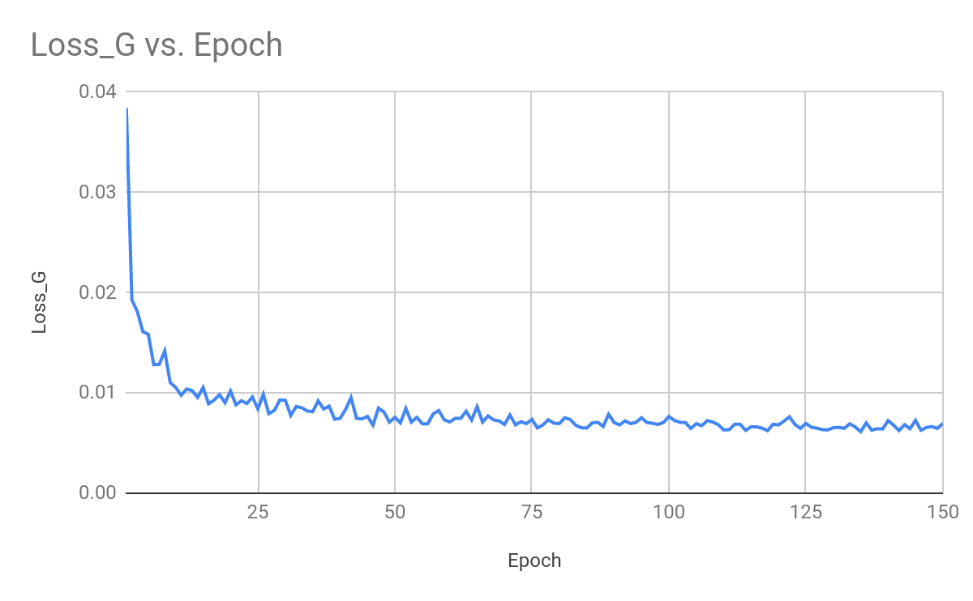
Generator loss vs. Epochs

Slide 24
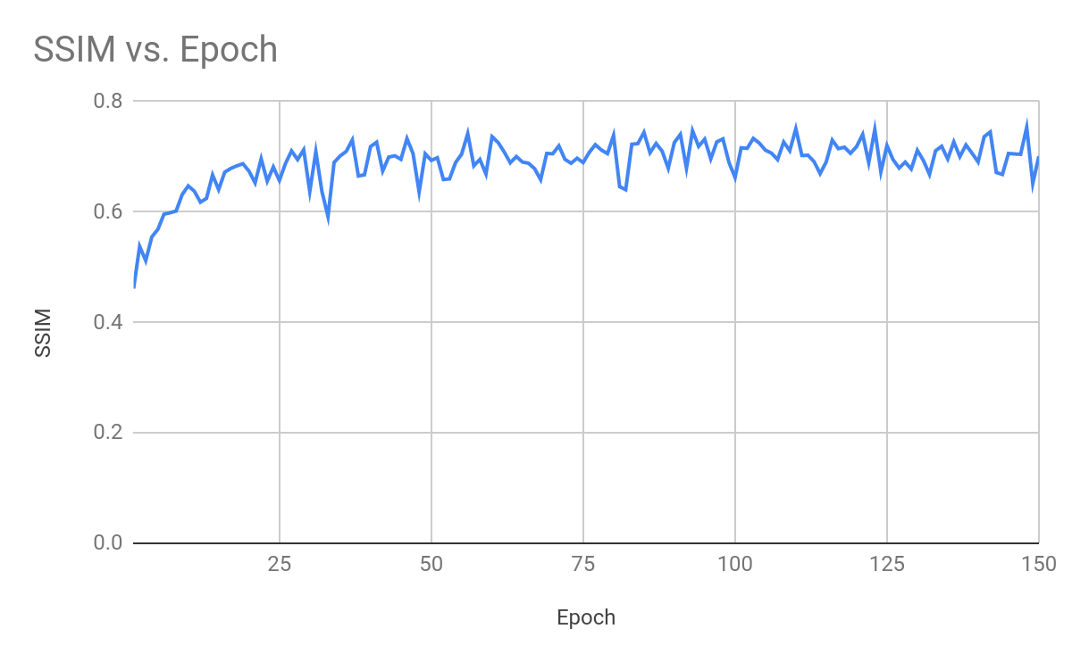
SSIM scores of validation set images

Slide 25
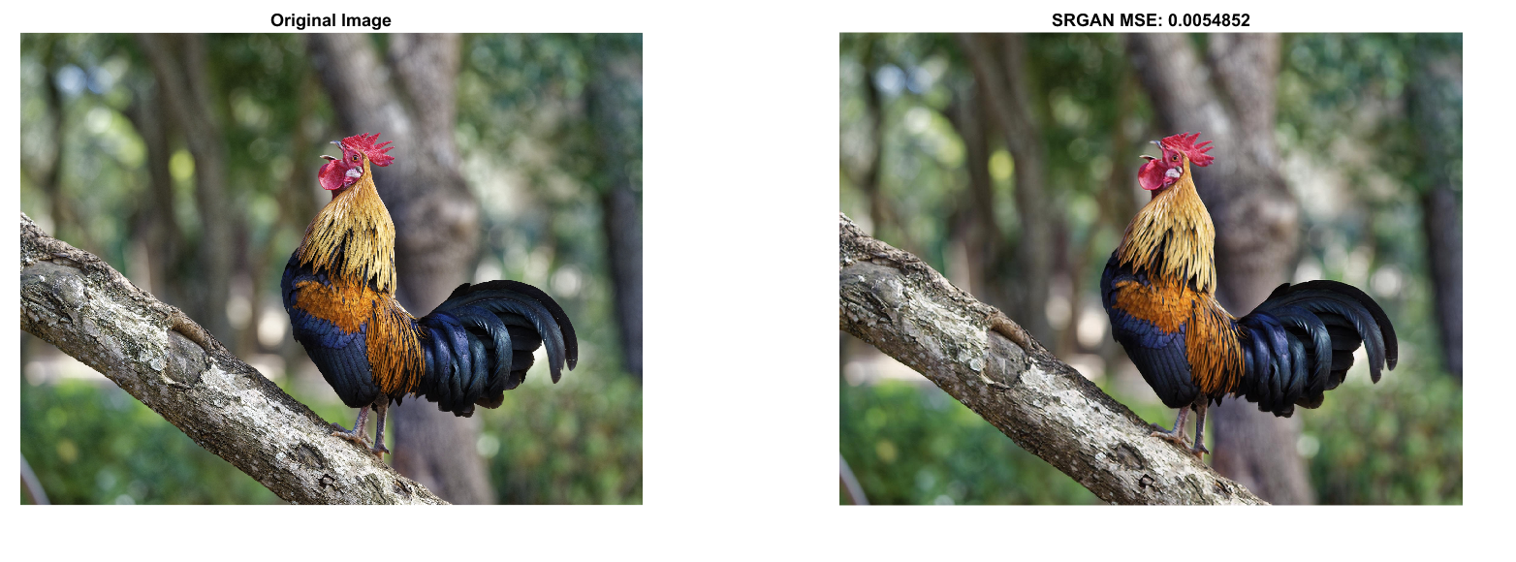
Training Results - 1

Slide 26
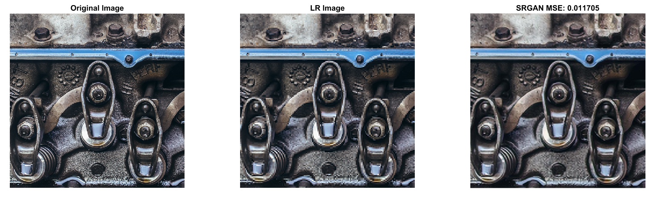
Training Results - 2

Slide 27
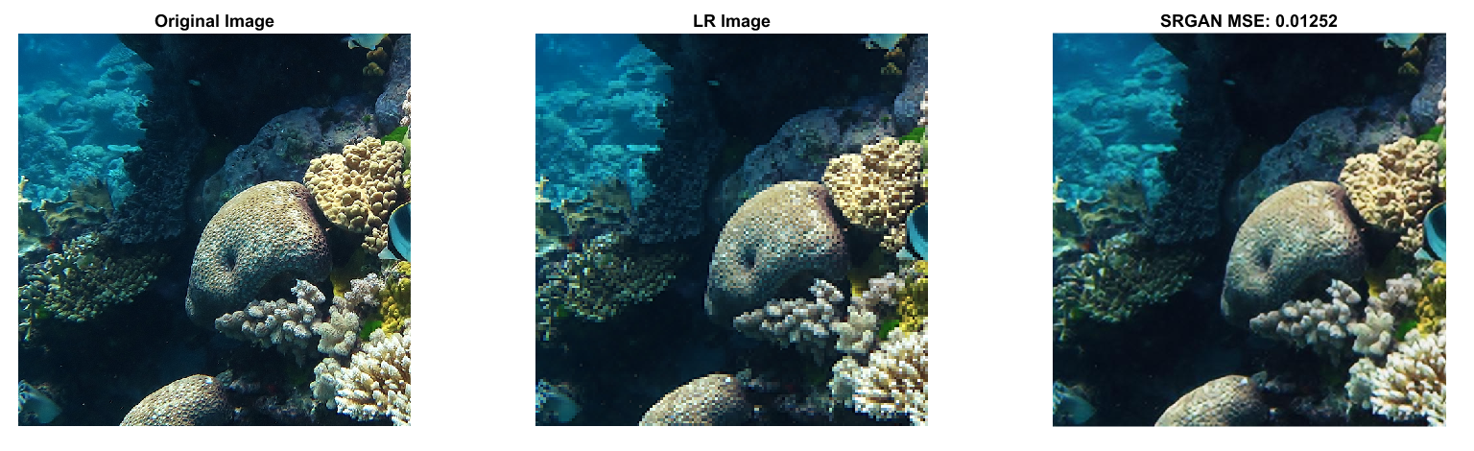
Training Results - 3

Slide 28
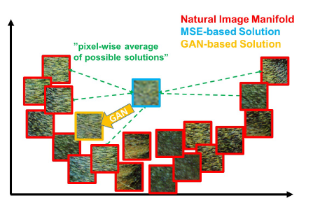
Advocate 2
For all HR patches, LR patches are nearly similar. When we feed all pairs to CNN, with MSE loss, our solution when minimising MSE, arrives at the solution which is pixel-wise average of all possible solution. Thus, this solution is smoother.
In contrast to this, GAN drives the reconstruction towards the natural image manifold producing perceptually more convincing solutions. This is true due to the fact the generator samples the image from the distribution it estimates for super-resolution image.
Figure illustration of patches from the natural image manifold (red) and super-resolved patches obtained withMSE (blue) and GAN (orange).
Image Source: Photo-Realistic Single Image Super-Resolution Using a Generative Adversarial Network

Slide 29
Conclusions - Kushal Shah (201701111)
The paper supports the use of deeper network architecture as they allow the mappings of very high complexity.
The difficulties in training these deep networks are resolved by skip-connections and batch-normalisation.
A major highlight of the paper is novel perceptual loss that makes the super-resolved image visually attractive.
By experiments and mean-opinion-score, the writers confirm that images super-resolved by SRGAN are visually more similar to original HR images.

Slide 30
Devil’s Advocate
Assertion:
The model tries to hallucinate the details.
Reasons:
The generative network is trained using the perceptual loss.
The perceptual loss pushes the network to model the mappings such that every smooth pattern is mapped to high-frequency, textured patterns.
This essentially means that we are creating the artificial details which might have no connection with ground reality.
Such artificial fill-up of the patterns make the model unsuitable for surveillance and medical applications.

Slide 31


Example:
Bicubic Interpolation
SR GAN

Slide 32

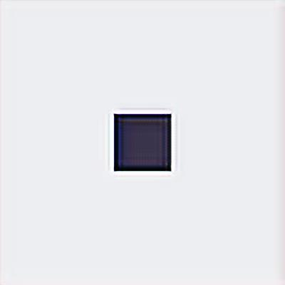
Example:
Original High Resolution SRGAN

Slide 33
Thank You

